Slide 1
ADD YOUR HEADSHOT HERE
ADD YOUR NAME AND JOB TITLE HERE

Slide 2
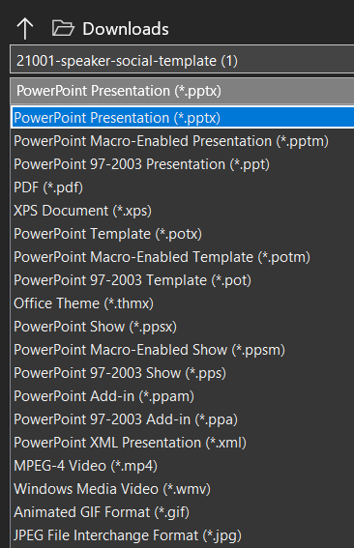
HOW TO USE THIS TEMPLATE
Add your HEADSHOT
Insert > Picture > This Device
Make sure you use a hi-resolution photo
Crop or resize your photo to fit the space
Add your NAME and TITLE in the textbox
SAVE a JPEG
File > Save As > Click dropdown under file name > Select JPEG File Interchange Format (*.jpeg)
CREATE A NEW POST on LinkedIn or Facebook. Include your jpeg and this link in your post: https://www.diaglobal.org/DIA2021

