Slide 1
Join me at
ADD YOUR
HEADSHOT
HERE
ADD YOUR NAME, JOB TITLE,
AND COMPANY HERE

Slide 2
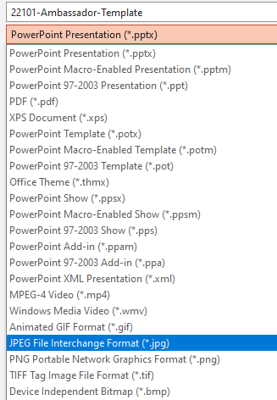
How To Use This Template
1. Add your HEADSHOT
Insert > Picture > This Device
Make sure you use a hi-resolution photo
Crop or resize your photo to fit the space
2. Add your NAME and TITLE in the textbox
3. SAVE a JPEG
Click File > Save As > In the dropdown under file name > Select JPEG File Interchange Format (*.jpeg)
4. CREATE A NEW POST on Social Media
Include your .JPEG photo and this link in your post: https://bit.ly/3Lrpdl1
Don’t forget to tag us on LinkedIn, Twitter, and Facebook!

Slide 3
I’m speaking at
ADD YOUR
HEADSHOT
HERE
ADD YOUR NAME, JOB TITLE,
AND COMPANY HERE

Slide 4
How To Use This Template
1. Add your HEADSHOT
Insert > Picture > This Device
Make sure you use a hi-resolution photo
Crop or resize your photo to fit the space
2. Add your NAME and TITLE in the textbox
3. SAVE a JPEG
Click File > Save As > In the dropdown under file name > Select JPEG File Interchange Format (*.jpeg)
4. CREATE A NEW POST on Social Media
Include your .JPEG photo and this link in your post: https://bit.ly/40E7L0O
Don’t forget to tag us on LinkedIn, Twitter, and Facebook!

